Slide 1
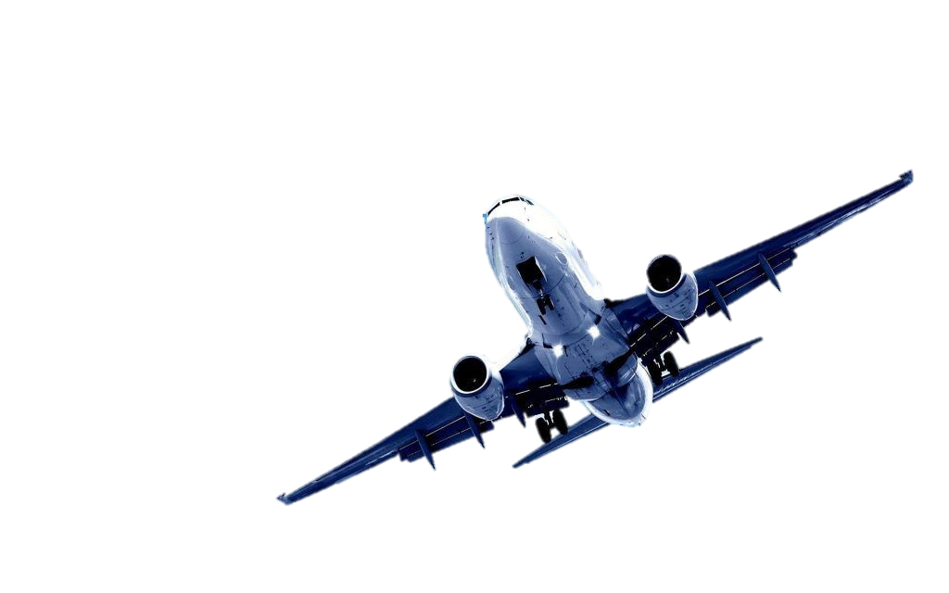
Airlines Delay Analysis
Notes:
This presentation is about business analysis of a startup airline company. The aim of this presentation is to give insights for CEO in the company by showing the status of the delay in the airports.

Slide 2
Agenda
Introduction.
Objective of the Analysis.
Flights with lowest average ticket price.
Flights with highest revenue.
Routes with highest revenue.
Flights with highest average ticket price.
Scenarios for adding Atlanta-Chicago route.
Notes:
So, the agenda for this presentation will cover an overview of the business of the company. Then, I will discuss the areas where the company is losing based on fuel cost by aircraft, revenue by flights, revenue by routes and average ticket price by flights. After that I will discuss the areas where the company is gaining based on almost the same criteria. And lastly, I will discuss the possible scenarios for adding Chicago-Atlanta route. So, I hope the show will be enjoyable.

Slide 3
Introduction
The Analysis is based on a dataset of more than 4200 records of internal flights in the USA.
The total number of columns in the dataset after “Data Wrangling” is 26 columns.
The time-frame of the analysis extend from June 2003 till January 2016.

Slide 4
Goal and Objective of the Analysis
Goal
To provide insights for the CEO of startup airline company. By showing the potential delays the new airline may encounter in different airports.
Objective
To build self-service dynamic and interactive dashboard that shows the performance of airport in term of the metrics of managing flight delays.

Slide 5
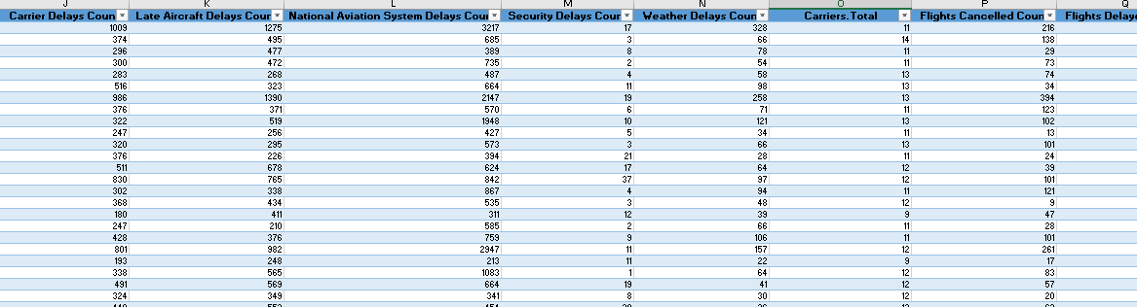
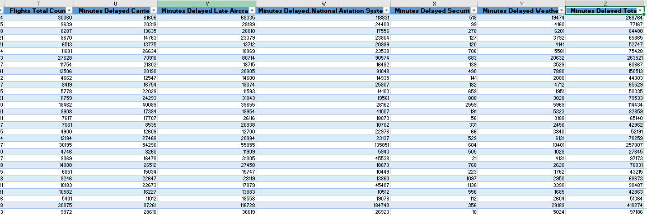
Challenge with Dataset
Several columns with several values.
Which columns to use?

Slide 6
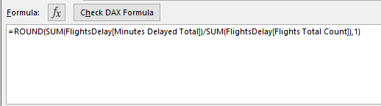
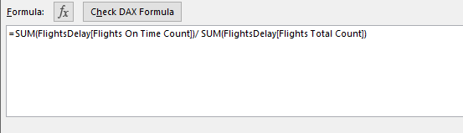
Data Standardization
Data Standardization for Comparison.
Average Delay per Flight.
% of On-Time Flights

Slide 7
General Metrics
% Flights Delayed = 20.28%.
% Flights Cancelled = 1.82%.
% Flights Diverted = 0.2 %.
% Flights On-Time = 77.67 %

Slide 8
Delay Trend Through the Year

Slide 9
Distribution of Delay Reasons

Slide 10
Top 10 Airports in Delay Time

Slide 11
Worst 10 Airports in Delay Time

Slide 12
Insights and Suggestions
The company should weights things out y looking to the general metrics to see if they are suitable for more investment in the business.
The company should make a plan to avoid delay surge during May, June, July and December.
The top management should talk to politicians to address the issue of Nation Aviation System Delay.
The company should investigate the reasons for Late Aircraft Delay (is it due to staff or machinery and how to reduce it).

